Slide 1
Reservation System

Slide 2

The reservation system offers a comprehensive solution for the efficient management of space reservations, whether parking lots, hotel rooms or swimming pools. It facilitates the user experience by allowing users to book the desired services faster and easier, optimizing organization and ensuring convenience. Our application improves business productivity by simplifying the booking process and ensuring a smooth experience for end users, all with a user-friendly and intuitive approach.

Slide 3
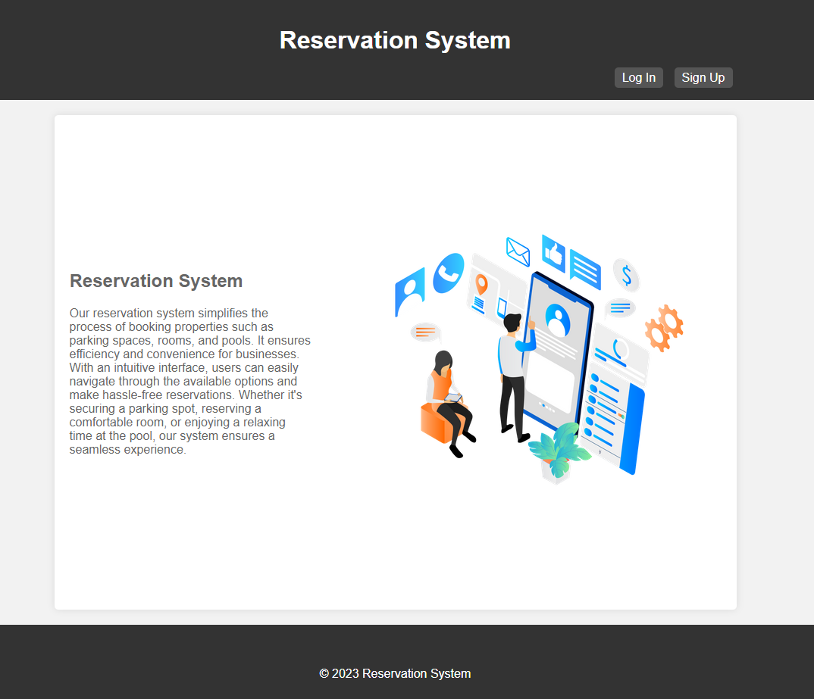
Users can easily register by providing their basic personal data, allowing them to access the system with their unique credentials. Once inside, they will have the freedom to explore and book a wide range of available services, be it a parking space, a room or access to a swimming pool.

Slide 4
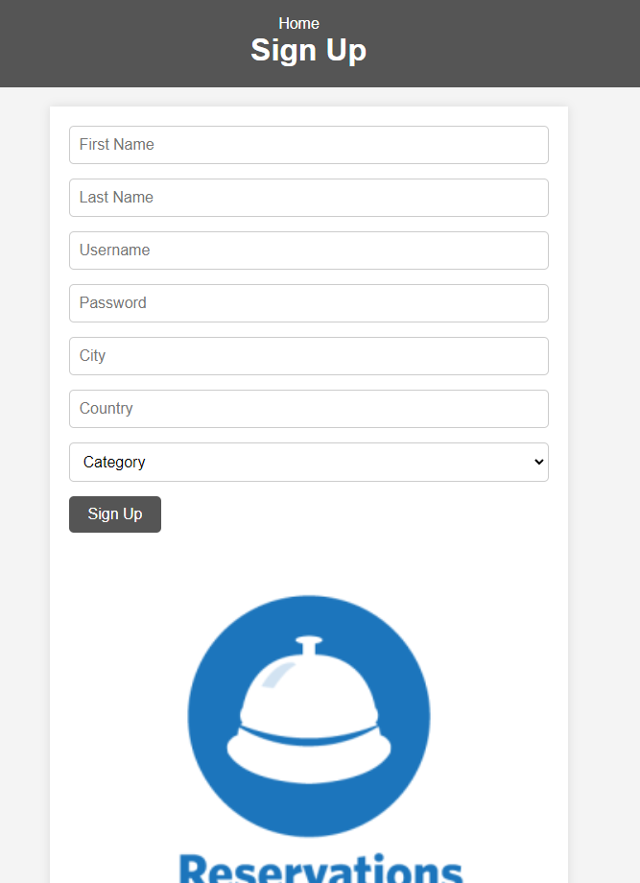
To register in the reservation system, simply fill in the registration form with your first name, last name, username, password, city, country and choose a user category. Once you have entered these data, click on the "Register" button to create your account.

Slide 5
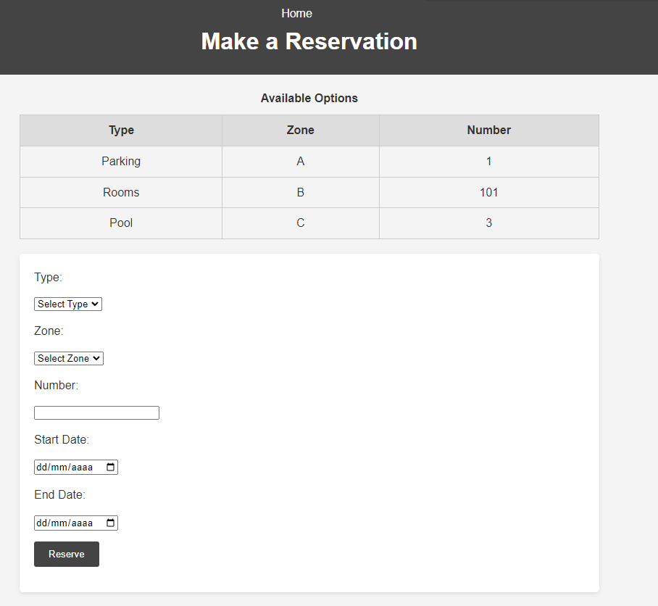
Once registered, log in with your username and password. On the main page, you will be able to select your preferred booking option: parking, rooms or swimming pool. Then choose the zone (A, B, C or D), the number of rooms desired and the start and end dates of your reservation.

Slide 6
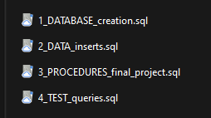

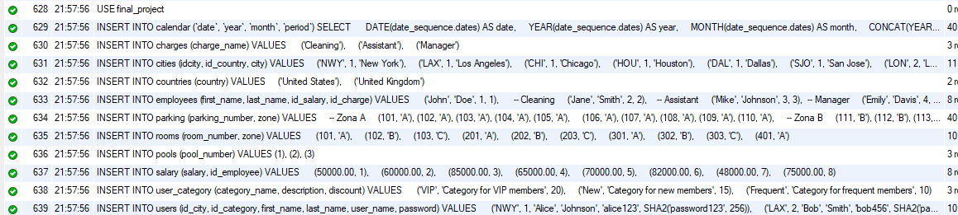
The files are in order:
the database is created,
insert the data in all tables,
different Store Procedures are created to handle the data.
different tests are performed on the database.

Slide 7
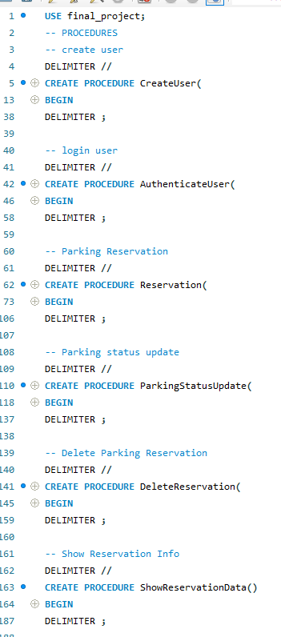
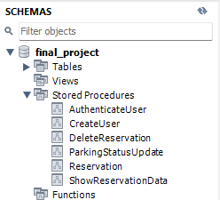
CreateUser: This procedure creates a new user in the database. It checks if the user already exists and, if not, adds a new record with details such as first name, last name, username, password, city and category.
AuthenticateUser: This procedure authenticates users at the time of login. It verifies the credentials provided by the user (username and password) with the database records.
Reservation: Allows space reservations (parking, rooms or pool). Checks availability on the specified dates and, if the space is available, makes the reservation.
ParkingStatusUpdate: Updates the status of a parking reservation. Verifies that the user has permission to modify the reservation and updates the reservation details according to the parameters provided.
DeleteReservation: Allows deleting a specific reservation after verifying that the user has the permission to delete it.
ShowReservationData: Retrieves detailed information about reservations made, including the associated user, the reserved location (parking, room or pool), the employee involved, the reservation status and the start and end dates.

Slide 8
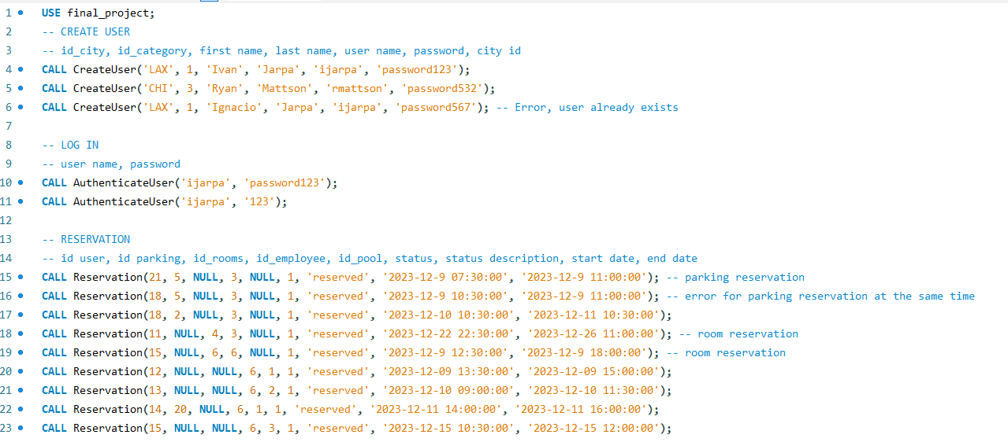
Finally, use the TEST queries file to test the different queries and ways to make a CRUD in the database.

